Slide 1
Research Report and Self-introduction for General Fusion
Xinhang Xu

Slide 2
Responsibility for Plasma Physicist job
Data interpretation
Model validation
Propose experiments
Dynamic model on ST
R1
R2
R3
R4

Slide 3
Self Introduction
我于2023年从中国科学技术大学博士毕业，专业是等离子体物理学。于2024年3月来到加州大学Davis分校从事博士后研究工作。 I have 9 years plasma physics experience from 2016- present, participated in the experiment task on EAST and NSTX-U tokamak, during the works on EAST, I developed modules to interpret the data from 2D-ECE, and also include model validation with experiment data. These models includes the non-thermal electron’s kinetic evolution, synthetic diagnostic of ECE, 3D-ray tracing and 2D FDTD simulation.

Slide 4
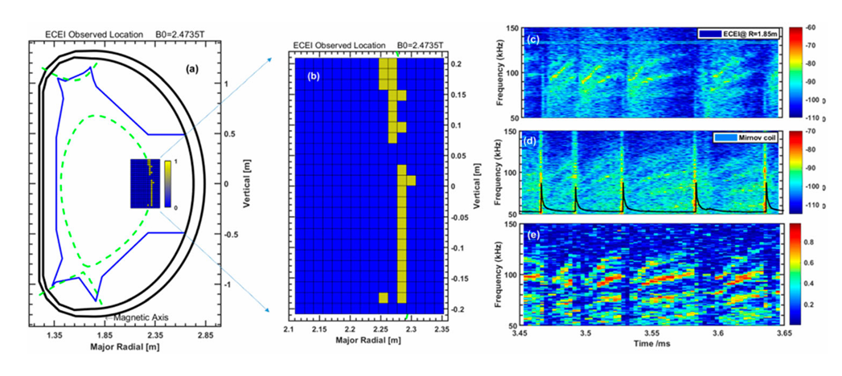
Works on Plasma Theory
1. Experimental observation of micro-tearing modes in the tokamak pedestal on EAST tokamak
Analysis the transport ,position, poloidal wavenumber of MTM at the pedestal after L-H transition
Figures of MTM position analysis and spectrometer analysis
Notes:
MTM : poloidal wave length: ~5 cm

Slide 5
Necessary: Micro-tearing mode physics is one crucial turbulent transport mechanism in tokamak edge plasmas. Understanding of the micro-tearing mode is important for the design and operation of fusion reactors;
R2
This work confirms that the micro-tearing mode lead to small particle flux transport experimentally which agree with the gyrokinetic simulation results and theory that indicate the transport is in heat flux , small particle flux.
Multi-diagnostics collaboration and validation: ECE, DBS, Mirnov coil, Polarimeter- Interferometer;
Data analysis: Short-Time Fourier Transform, correlation analysis.
Theory and simulation analysis: For this study, gyrokinetic simulation could help to analysis the physics process of micro-tearing mode or other small scale turbulence , while NIMROD is used to analysis the macroscopic MHD, maybe not suitable for such phenomenon research.
R3
R1

Slide 6
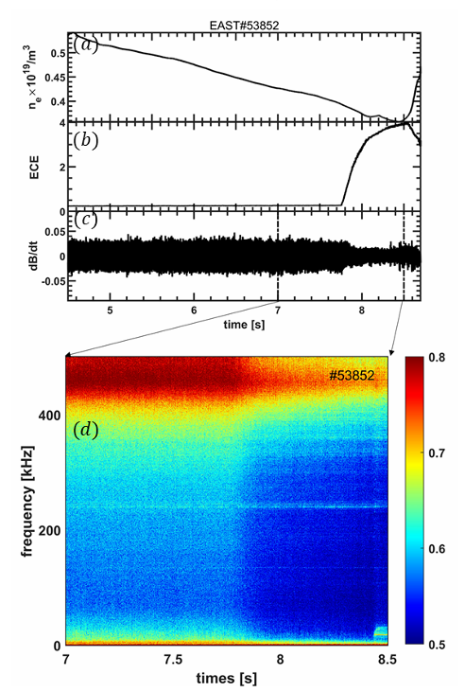

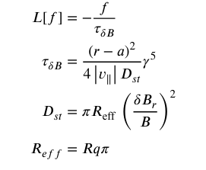
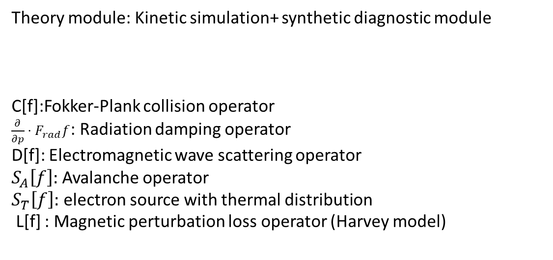
2. No-thermal emission with magnetic perturbation
How to understand sudden rise ECE emission?
Theory module: Kinetic simulation+ synthetic diagnostic module
C[f]:Fokker-Plank collision operator
$\frac{∂}{∂p}⋅F_{rad}f$: Radiation damping operator
D[f]: Electromagnetic wave scattering operator
$S_{A}\left[f\right]:$ Avalanche operator
$S_{T}\left[f\right]:$ electron source with thermal distribution
L[f] : Magnetic perturbation loss operator (Harvey model)
R4

Slide 7
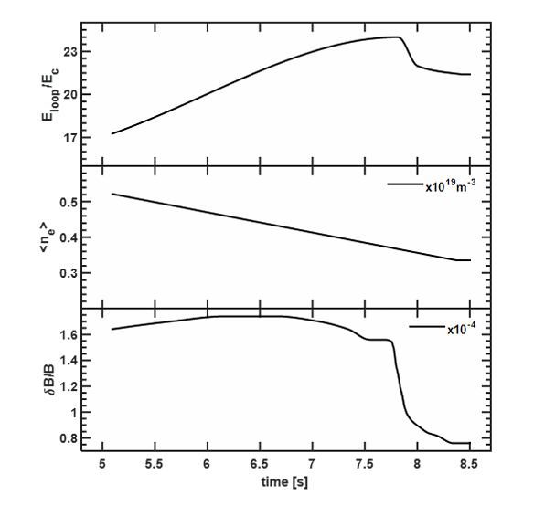
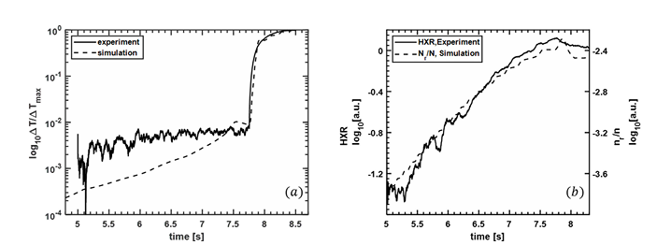
Input parameters into module
Comparison of output parameters with experimental data
Diagnostic : ECE, Mirnov coil, HXR, Polarimeter- Interferometer, Loop voltage diagnostic
R1
Compare with experiment results, we found the no-thermal emission is highly related with magnetic perturbation, and simulation results are quantality agree with experiment results
R2

Slide 8
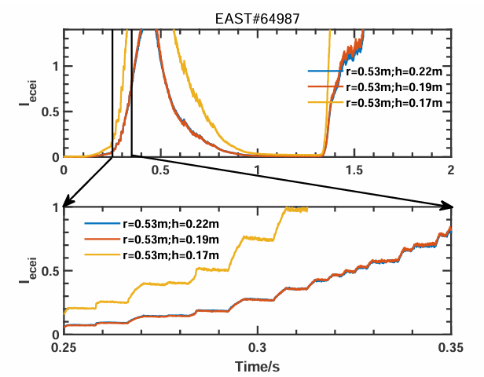
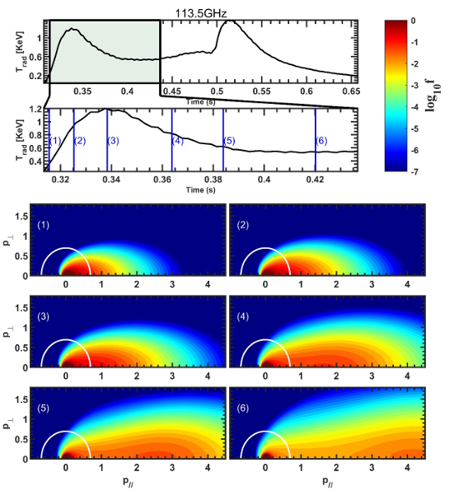
3. Abnormal electron cyclotron emission at the startup phase of tokamak
R1
R4
Abnormal increase of ECE emission and step structure in the rise phase
Analysis module:
Kinetic simulation + synthetic diagnostic
Results: Avalanche process lead to the abnormal emission while the anomalous doppler effect lead to the step structure (Xinhang Xu et al 2025 Chinese Phys. B)

Slide 9
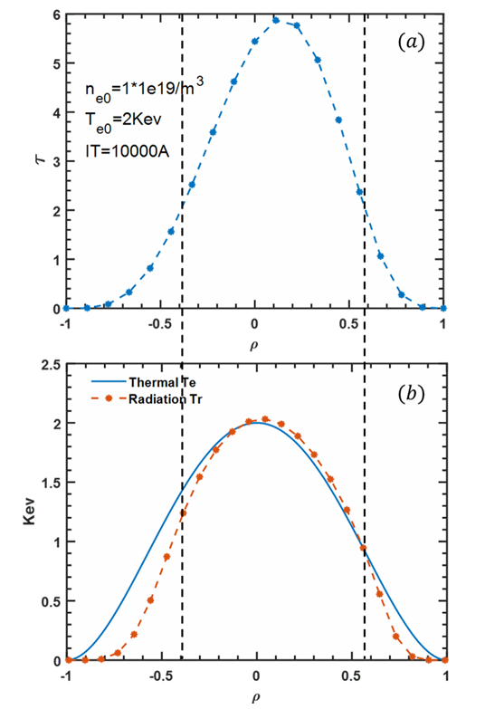
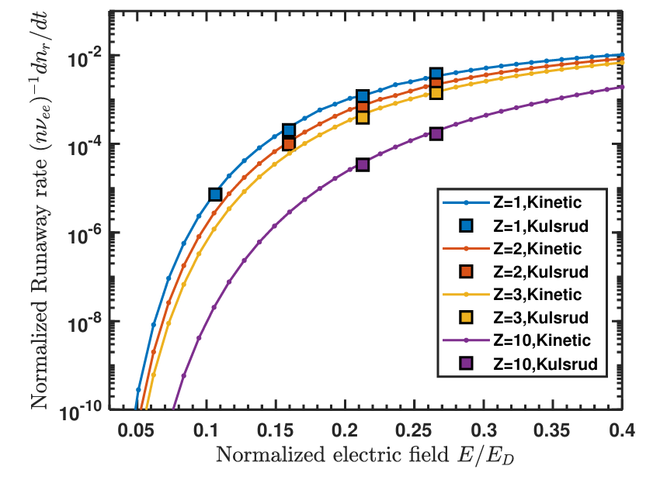
R2
Module validation :
Synthetic module validation
Kinetic module validation
Compare the runaway electron growth rate with previous results (Kulsrud, PRL,1973) under same condition
Check if the radiation temperature close to thermal temperature under optical thick condition

Slide 10
Manage experiment experience
R3
In EAST team, typical we have fellow steps:
Step 1: Initial Experiment Design
Define plasma and key parameter space (For MTM, typical require H-mode )
Plan auxiliary heating, plasma current, and q-profile (For MTM, ECRH or ICRF could help to achieve H mode condition )
Identify essential diagnostics and scanning parameters
Step 2: Collaboration and Coordination
Work with other machines and research teams, figure out the valuable research topic
Step 3: Shot Selection and Execution for plan-B
Select experiments within limited shot range
Account for unexpected machine issues, diagnostic availability, and heating constraints

Slide 11
Communication in complex project
In EAST team, typical we have fellow steps:
Step 1: Project Initiation and Planning
Conduct startup meetings with essential team leaders and machine operators
Coordinate with diagnostics coordinator to check availability, plan measurements, and explore piggyback opportunities
Review experiment proposals with research team, operation team, and diagnostics team
Step 2: Experiment Execution and Monitoring
Check experiment status and diagnostics status during plasma shots
Step 3: Post-Experiment Reporting
Prepare 1-day quick report after the experiment
Produce detailed experiment reports for internal use or public publication

Slide 12
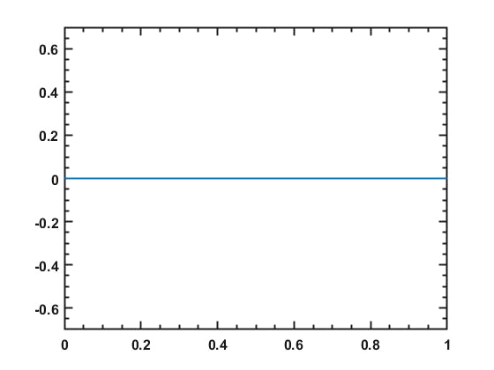
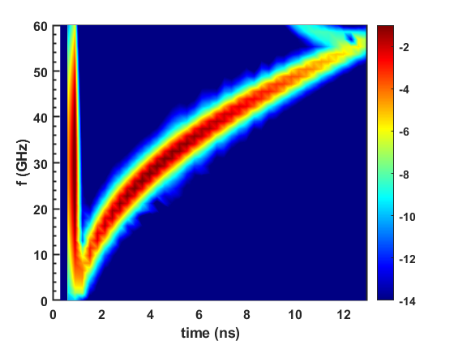
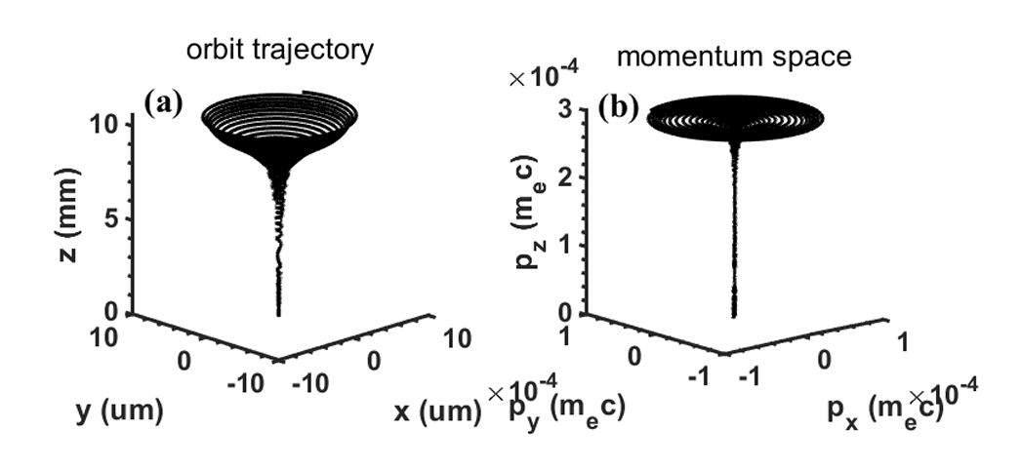
Programming skill
Kinetic + synthetic simulation (+2000 lines)
1D-FDTD simulation in plasma for USPR(+2000 lines)
3D ray-tracing simulation (450 lines)
Wave-particle resonant simulation (+500 lines)
1.3D ray-tracing : https://git.lug.ustc.edu.cn/XuXinhang/ray-tracing3d.git
2.Kinetic + synthetic simulation: https://git.lug.ustc.edu.cn/XuXinhang/kinetic_simulation.git
3.2D fdtd simulation : https://git.lug.ustc.edu.cn/XuXinhang/fdtd_2d.git

Slide 13
Summary
Synthetic diagnostic is important for data interpretation , which build a bridge from model to real-world experimental data. I have written than 10000+ line code for different projects with user friendly, released for group users on GitHub, and interesting in physics research based on numerical simulation. This projects include model development by self and corporation , model validation, data interpretation and analysis, like kinetic simulation and synthetic diagnostic; Good at MATLAB, python is also ok for me.
I also have abundant experimental data analysis experience, take part into diagnostic management and development. Like high-k scattering system and FIReTIP laser control and optimization for NSTX-U.

